Slide 1
Lessons Learned

Slide 2
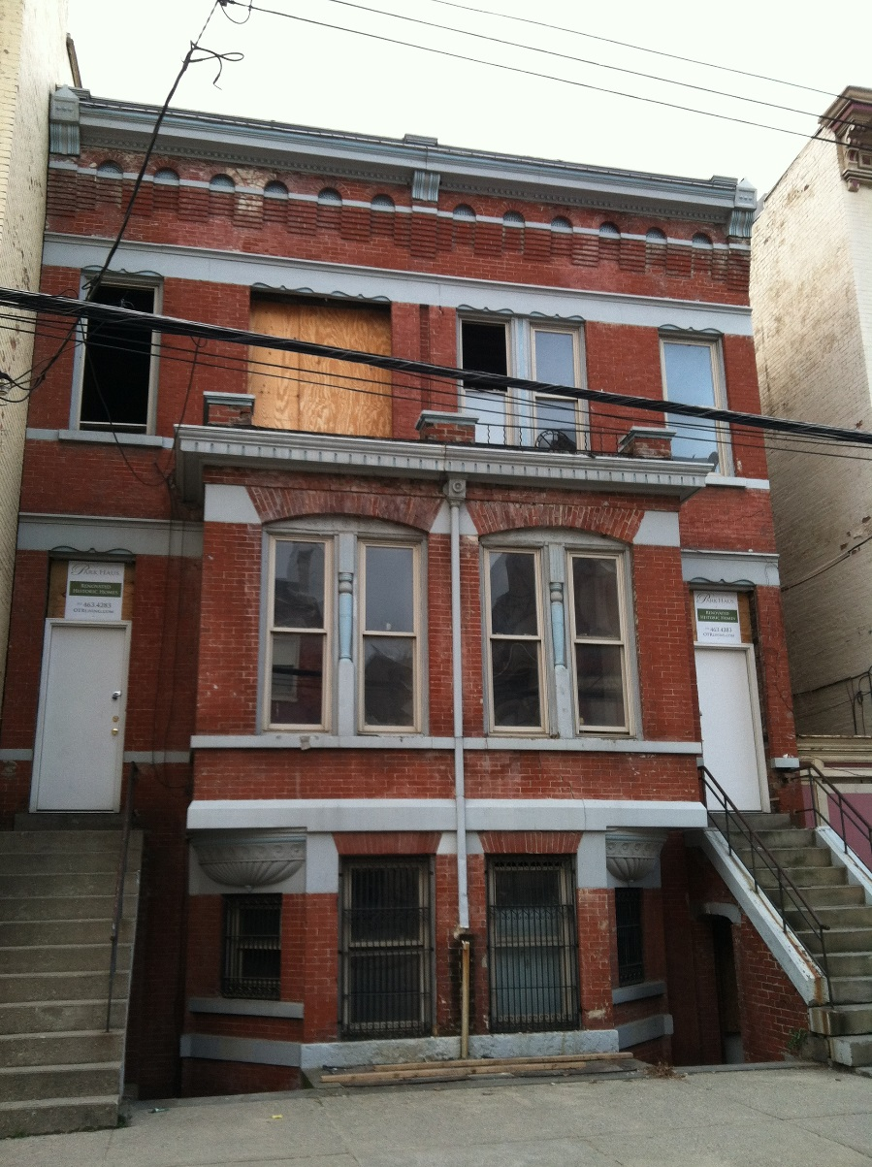
1405-07 Elm

Slide 3
1405-07 Elm:
Goal: raise a family in OTR
LEED Platinum, Historic Preservation
4-unit (owner-occupied) apartment
2x 1-car garages
Present structure built in 1886
5,400 SF at purchase
4,800 SF at completion + full basement
Purchased: Dec. 2013 for $275,000
Construction cost: ~$800,000

Slide 4
1405-07 Elm: The Team
Developer: Elm St. Ventures
General Contractor: Daniels Homes
General Architect: Norris & Dierkers
LEED/Historic Architect: Steve Hampton
Legal/Financial/Tax Consultant: Don Longwell
Seller/Partner: 3CDC
Lender: Central Bank
LEED Consultant: SOL Development
Local Vendors: Greener Stock, Switch, Cooknee, Keidel, Rookwood Pottery, & more

Slide 5
1405-07 Elm: Financing Structure
Acquisition loan
Construction loan
Mortgage
State Historic Tax Credit
Federal Historic Tax Credit
Federal Solar Investment Tax Credit
City of Cincinnati 15-yr LEED tax abatement
Solarize Cincinnati cash rebate
Duke Energy Rebates

Slide 6
1405-07 Elm: Challenges & Lessons Learned
Biggest Challenge
APPRAISAL
Lessons Learned
Develop a plan, triple your timeframe
LEED Platinum: Don’t be afraid
Even the most complex financing structure is still accessible

Slide 7
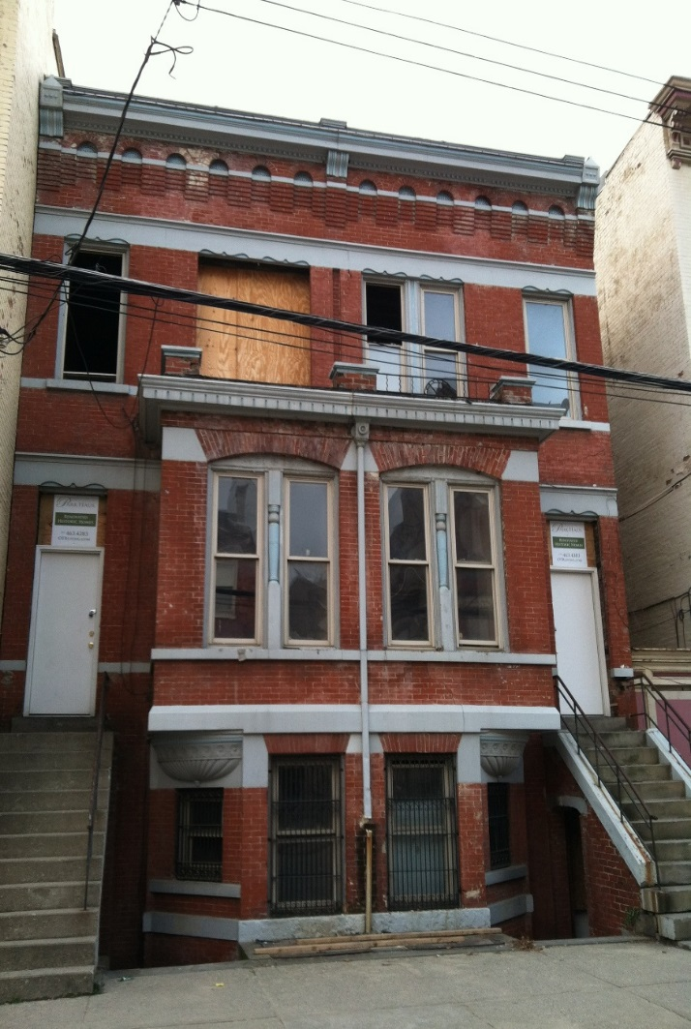
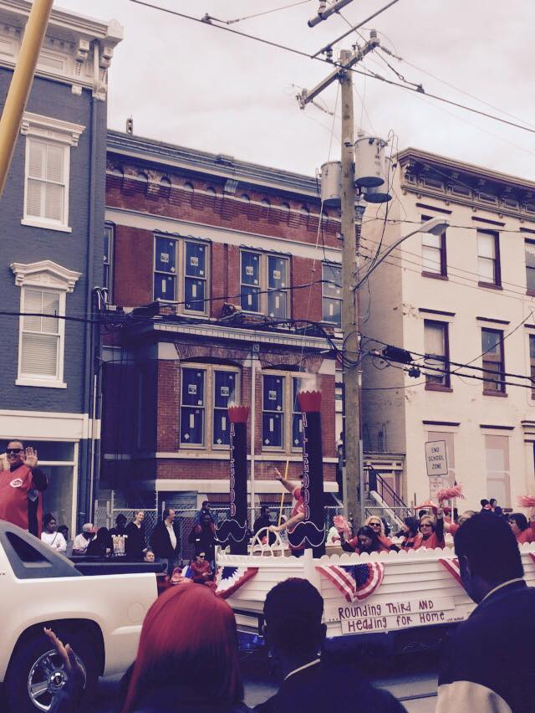
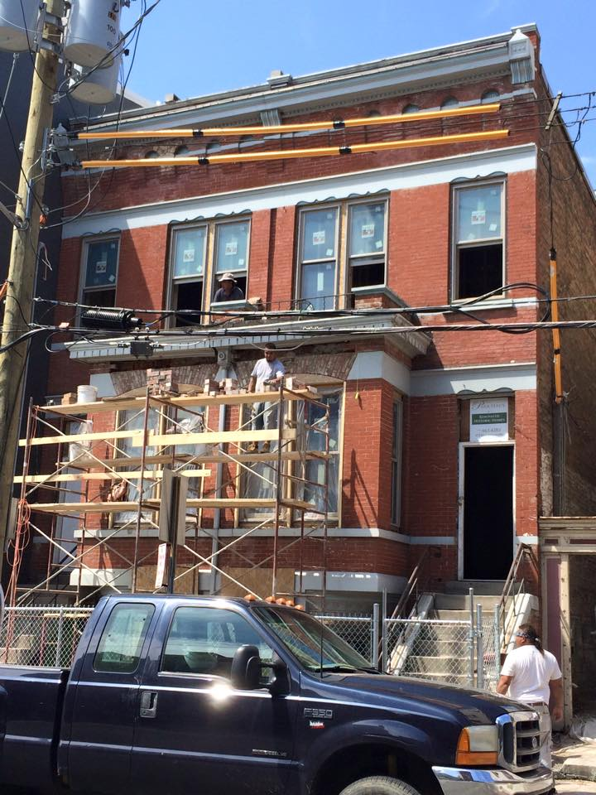
1405-07 Elm: The Facade

Slide 8
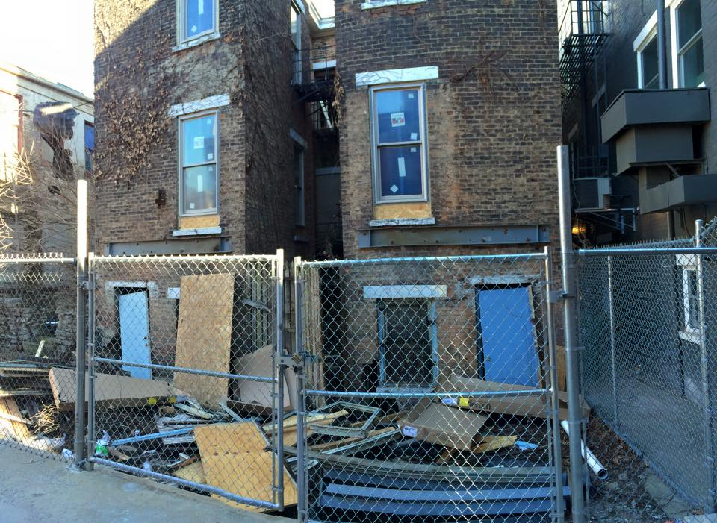
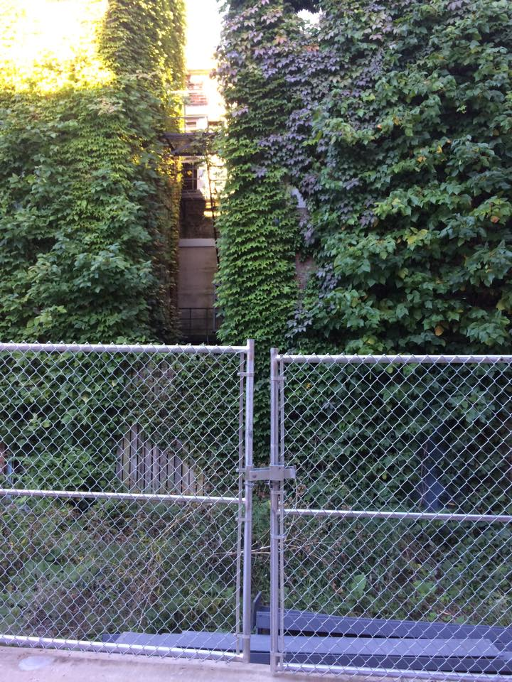
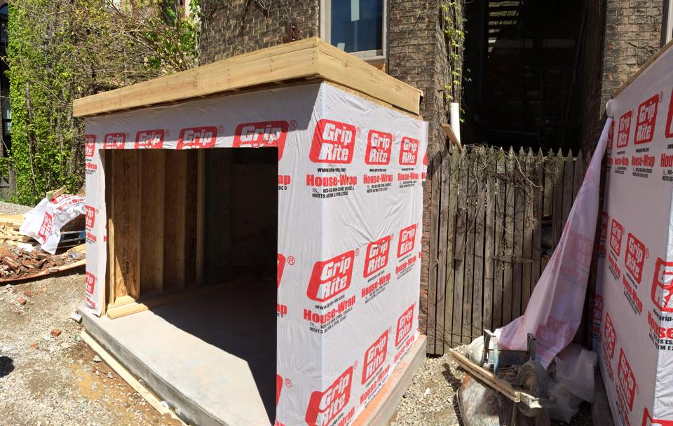
1405-07 Elm: The Garage

Slide 9
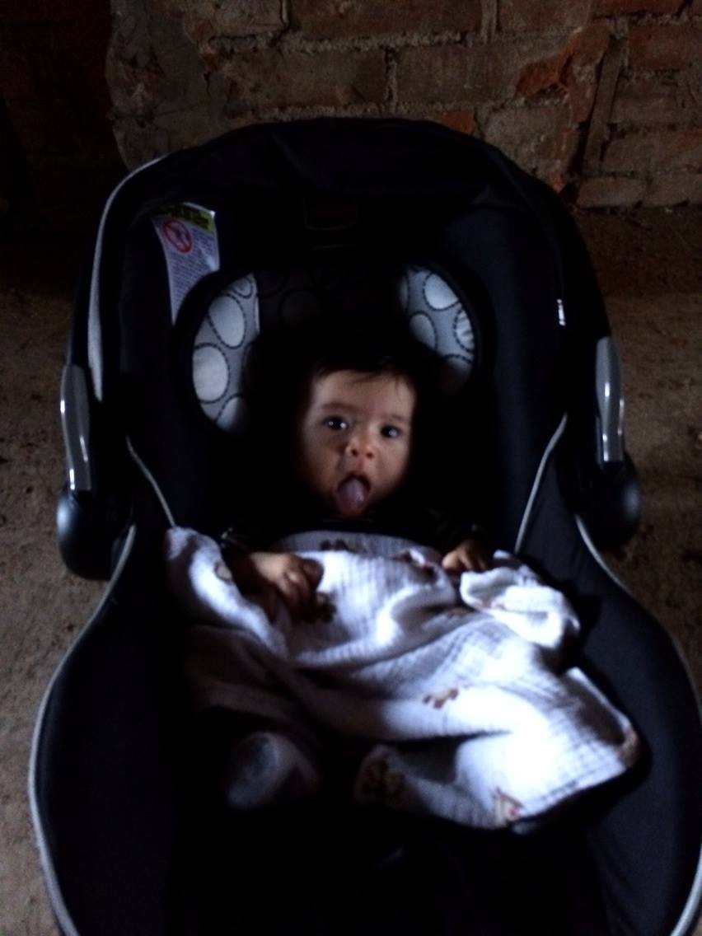
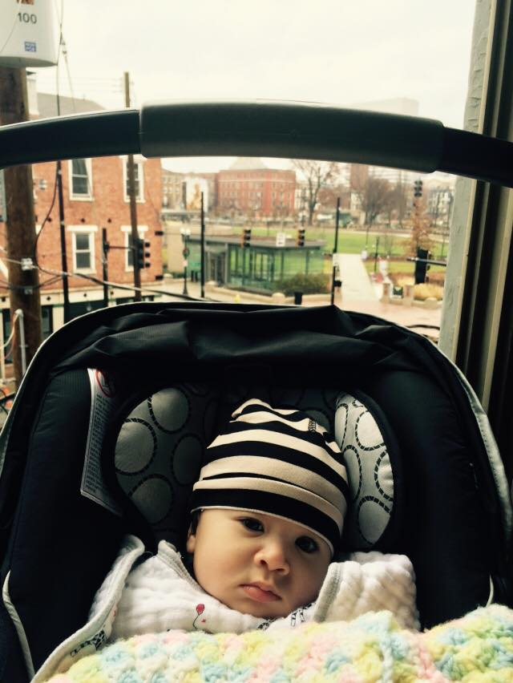
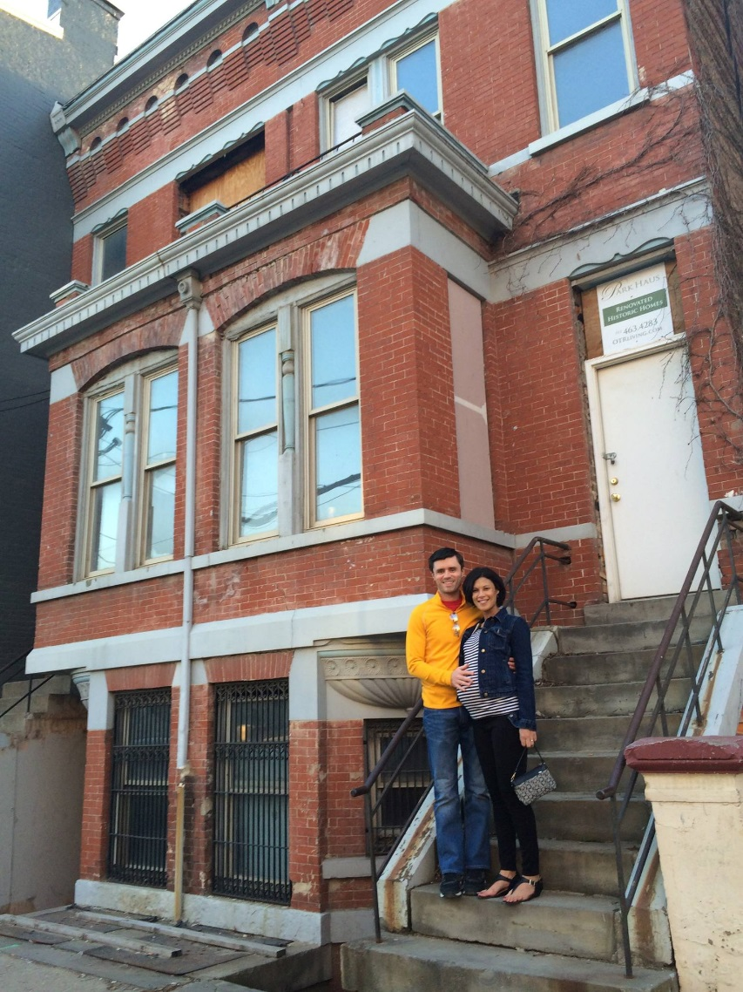
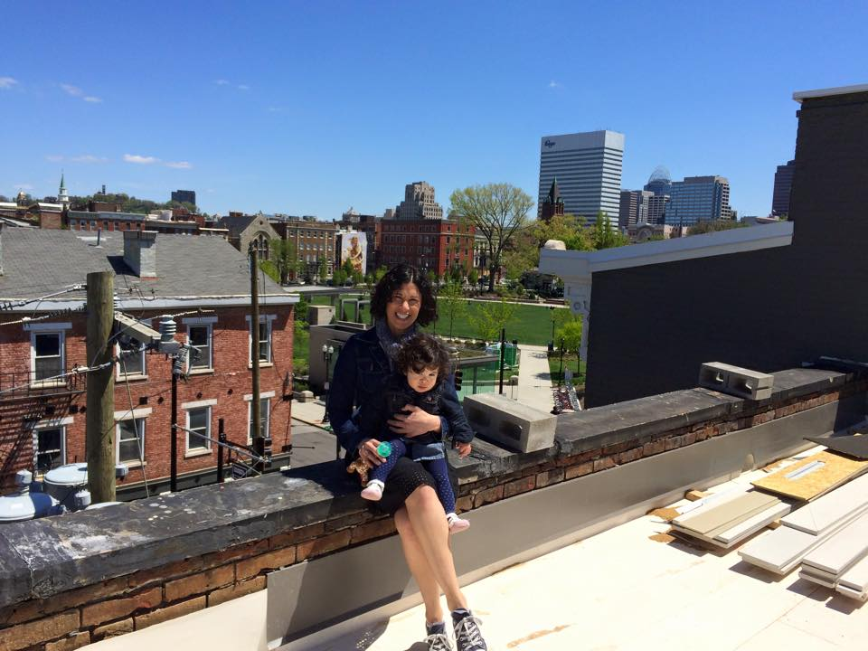
1405-07 Elm: Baby Approved

Slide 10
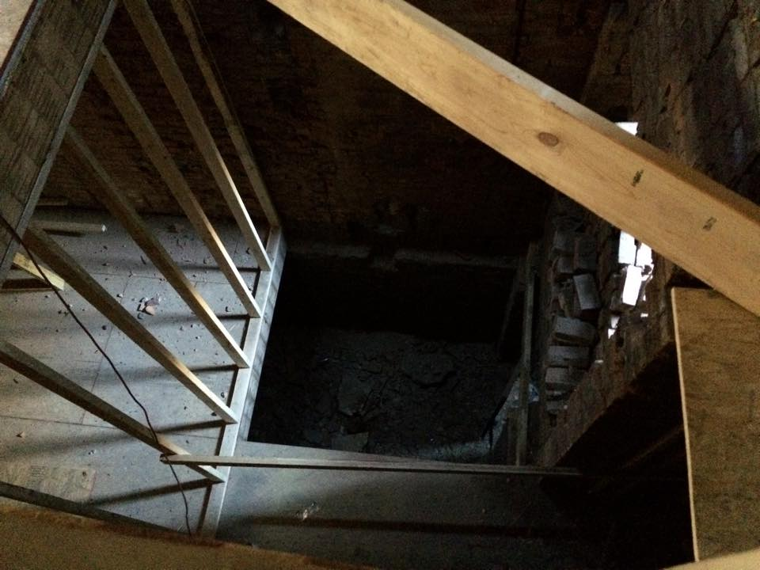
1405-07 Elm: Staircase

Slide 11
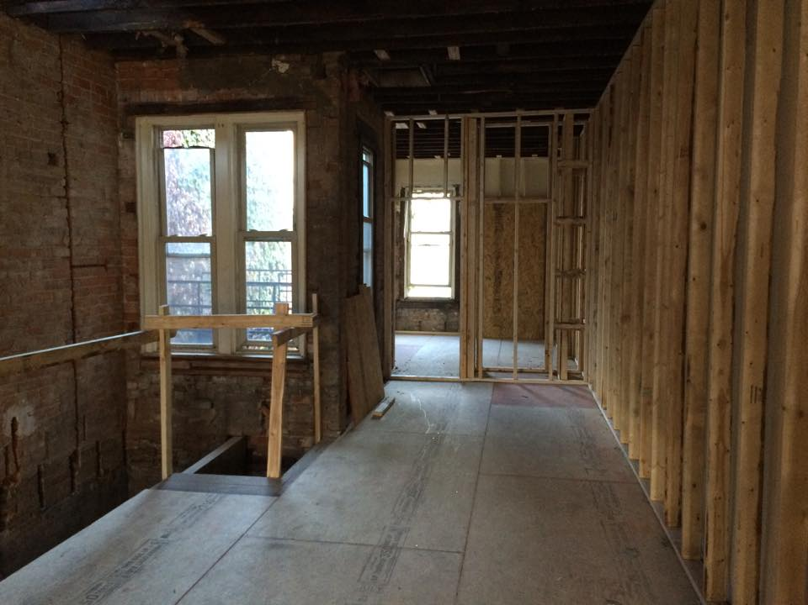
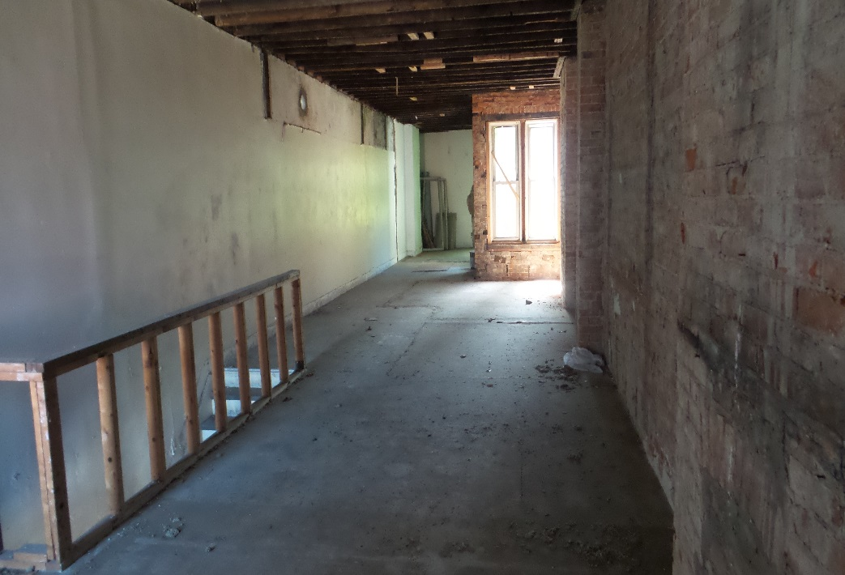
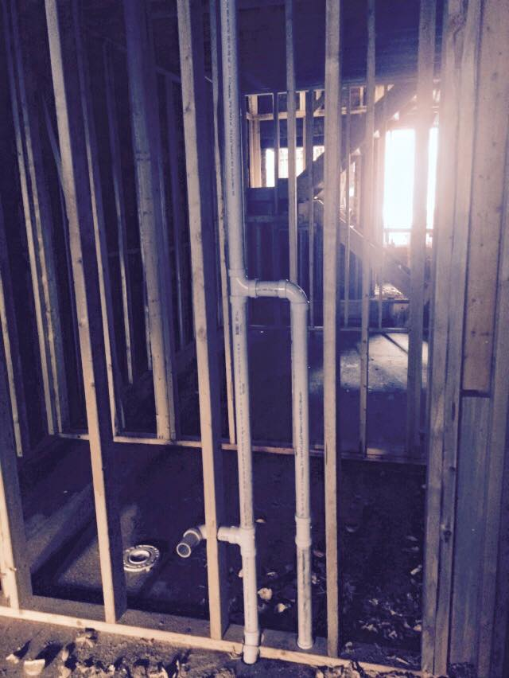
1405-07 Elm: Bedrooms

Slide 12
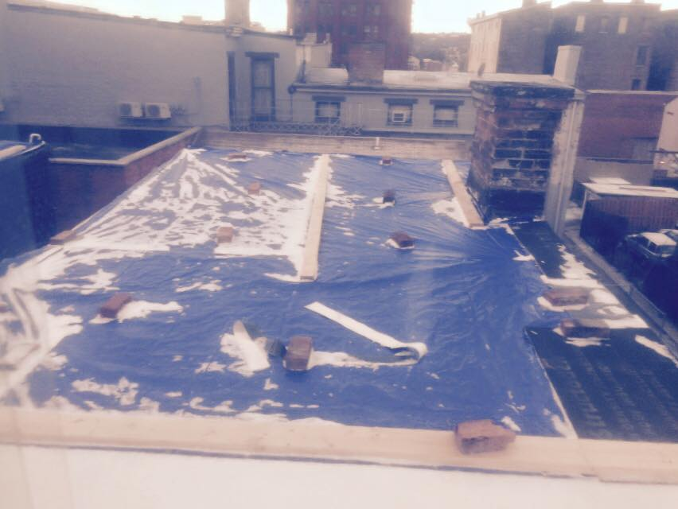
1405-07 Elm: Future Solar Power Plant

Slide 13
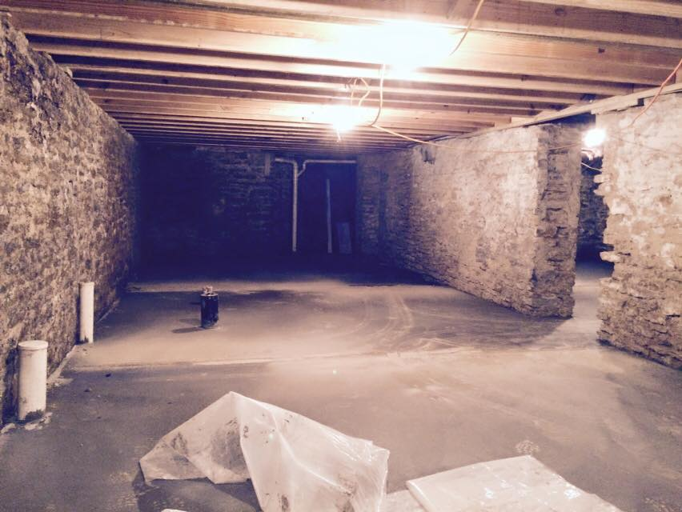
1405-07 Elm: Sub-basement

Slide 14
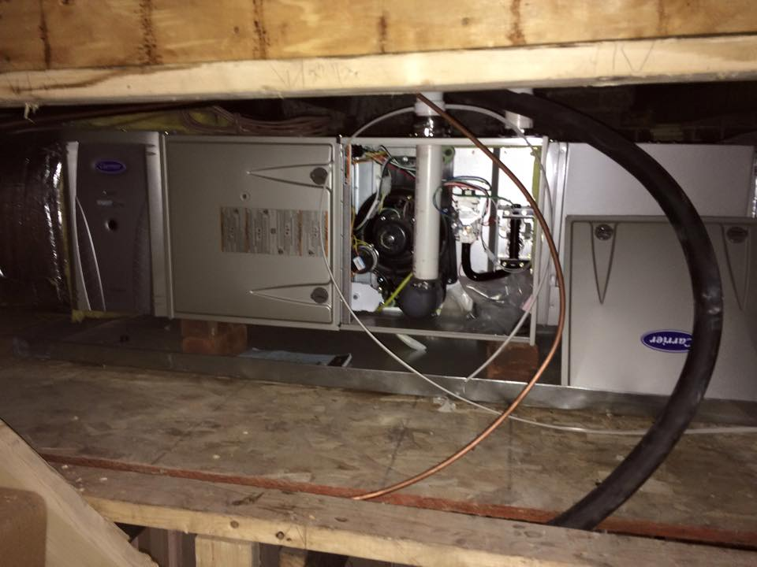
1405-07 Elm: Zoned HVAC

Slide 15
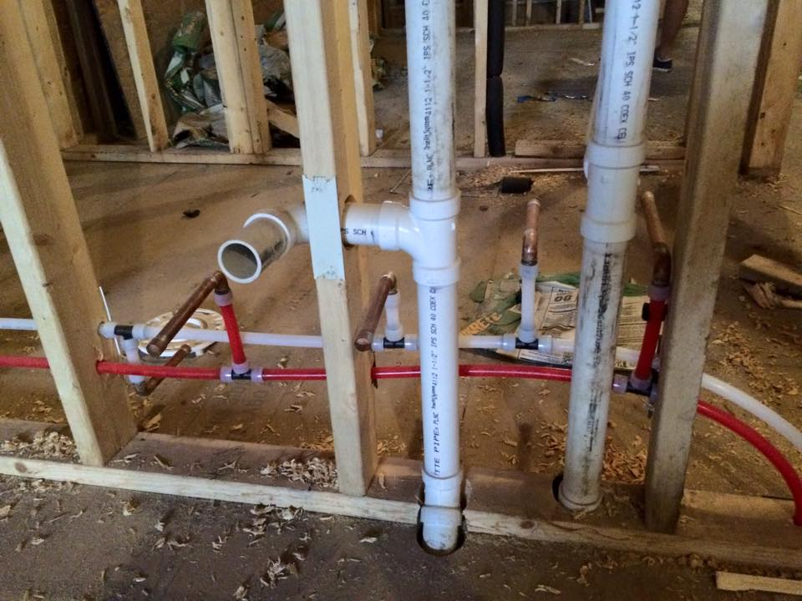
1405-07 Elm: Plumbing

Slide 16
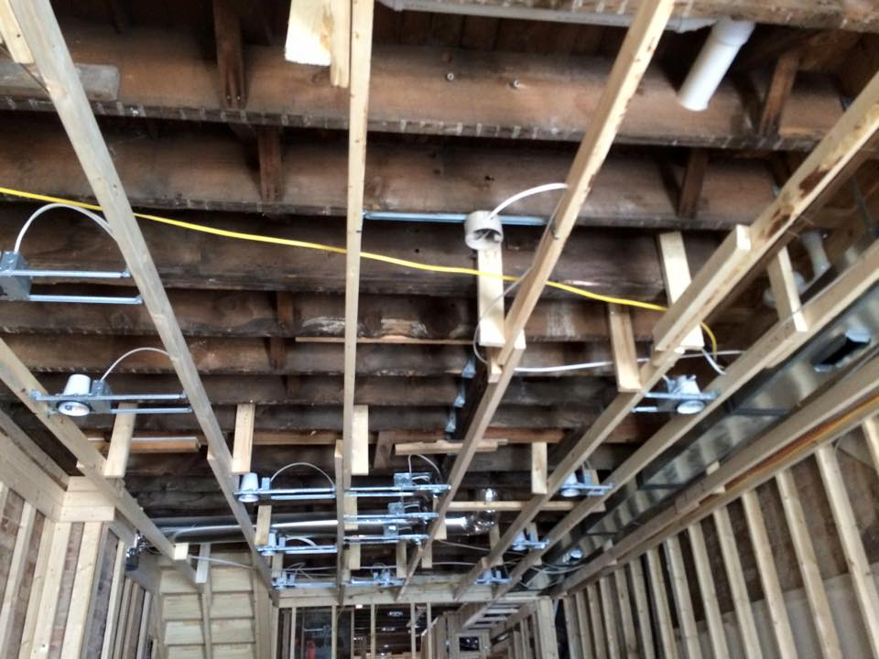
1405-07 Elm: Electrical

Slide 17
Overview 105-107 Elm St.
Goal: raise a family in OTR
LEED Platinum, Historic Preservation
4-unit (owner-occupied) apartment
2x 1-car garages
Present structure built in 1886
5,400 SF at purchase
4,800 SF at completion + full basement
Purchased: Dec. 2013 for $275,000
Construction cost: ~$800,000
The Team
Developer: Elm St. Ventures
General Contractor: Daniels Homes
General Architect: Norris & Dierkers
LEED/Historic Architect: Steve Hampton
Legal/Financial/Tax Consultant: Don Longwell
Seller/Partner: 3CDC
Lender: Central Bank
LEED Consultant: SOL Development
Local Vendors: Greener Stock, Switch, Cooknee, Keidel, Rookwood Pottery, & more
Financing Structure
Acquisition loan
Construction loan
Mortgage
State Historic Tax Credit
Federal Historic Tax Credit
Federal Solar Investment Tax Credit
City of Cincinnati 15-yr LEED tax abatement
Solarize Cincinnati cash rebate
Duke Energy Rebates
Biggest Challenge
APPRAISAL
Lessons Learned
Develop a plan, triple your timeframe
LEED Platinum: Don’t be afraid
Even the most complex financing structure is still accessible

Slide 18
1405-07 Elm: Reach out anytime
Andy Holzhauser
OTR Foundation Trustee
CEO, Greater Cincinnati Energy Alliance
513.309.7081
Andy.Holzhauser@yahoo.com

